Slide 1
Trees, Structure Ignitions, and Science
SDRUFC, June 5
Add speakers list

Slide 2
SECTION FOR ANNE
Urban forester Anne Fege will outline current state and local brush management codes, and the limited empirical science behind them.
SHORTEN, choose concepts and slides that relate to trees and structure ignition
These slides are from Living with Wildfire presentations

Slide 3
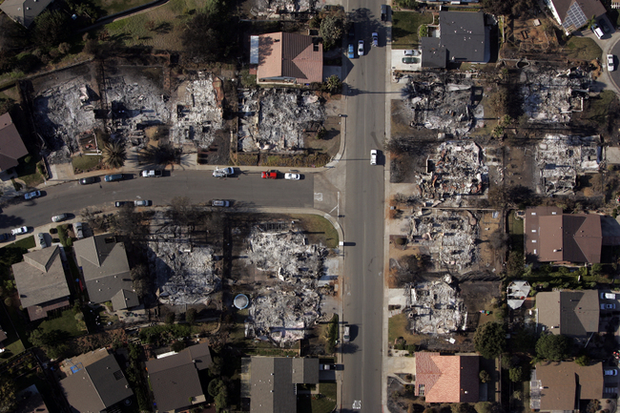

Focus on the
Home Ignition Zone
Create sustainable, fire-wise environments for our homes by starting from the house out rather than from the wildland in
  Building materials and design
  Homesite materials and maintenance
  Personal responsibility
  Community cooperation

Slide 4

Fire Basics: The Fire Triangle
  Oxygen: fires burn aggressively in strong Santa Ana winds
  Fuel: vegetation, wood decks, houses, gazebos, etc.
  Heat: fuels can ignite from embers, heat or flames

Slide 5
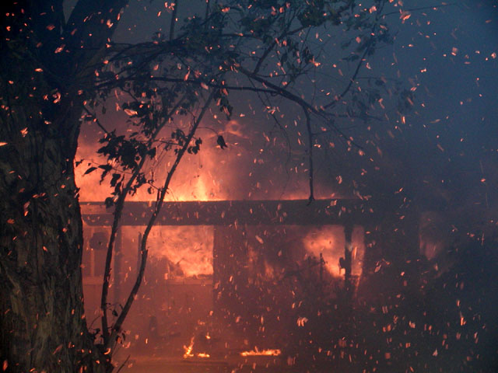
Embers
The transfer of heat through objects in direct physical contact (conduction)
  Smoldering pieces of fuel carried by winds that can travel well ahead of fire front and ignite homes and vegetation far from the main fire
  Ember attack is the main cause of structure losses and damages (80%)
  Example: embers falling
  on wood roof, landing on
  horizontal surfaces, or
  entering into vents
Notes:
Explain the associated methods of heat transfer-conduction, convection, radiation that result with ember attack…not just focus on far traveling embers

Slide 6
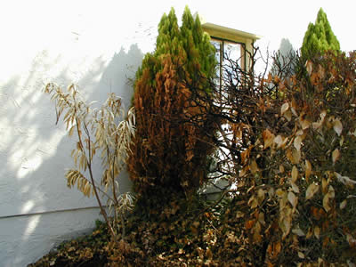
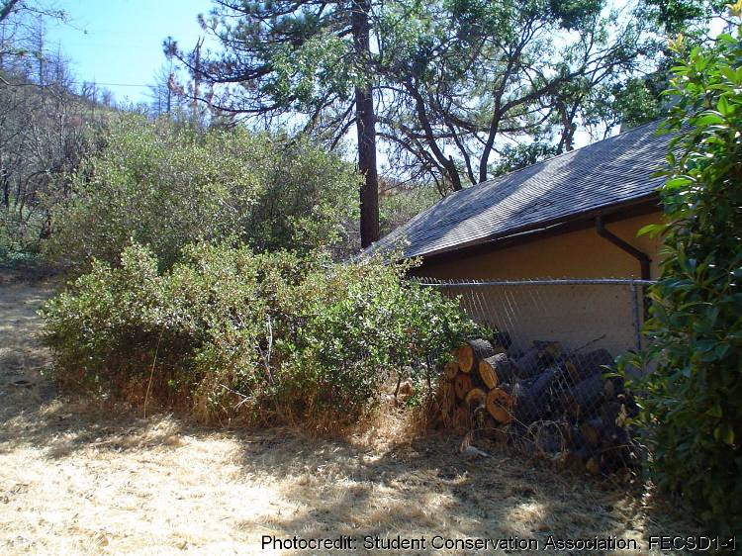
Heat
Transfer of heat through rays (radiation)
  Vegetation (ignited by embers!) burning next to combustible materials
  Examples: woodpile burning next to house, neighbor’s house burning…..

Slide 7
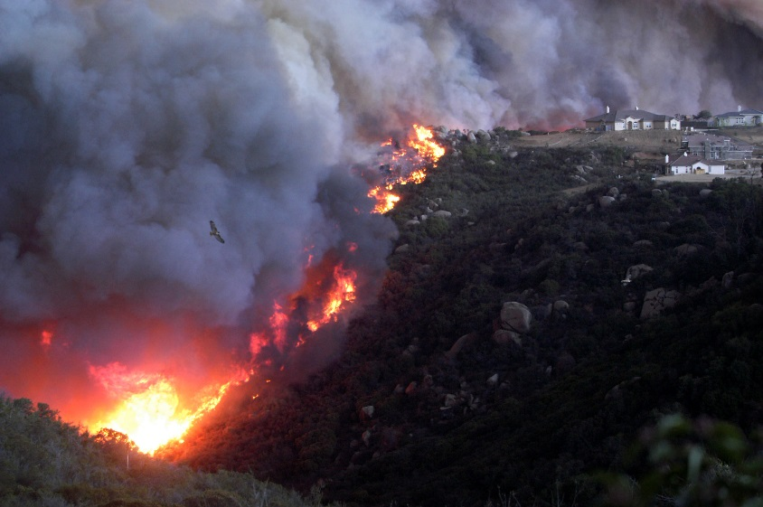

Flame
The transfer of heat through gases or liquid (convection)
  Flame length depends on burning material (chaparral, trees, shake roofs, houses)
  Typically southern California wildland flames concentrate two to five minutes in one place, not hot or long enough to ignite structures
Notes:
The duration time that the flames contact the structure depends on the size of the fuel, density of the fuel, and distance the structure is from the fuel source (vegetation, wood pile, another structure, etc.). Typically, flame contact with the structure is from 2-5 minutes in Southern California fuel types, as demonstrated on the next slide [“Landscape and Building Design for Bushfire Areas,” Ramsay & Rudolph, CSIRO].
As demonstrated by the photo and the graphic, topography can increase the risk to the structure depending on the steepness of the slope and the distance the structure is from the top of the slope. Typically, the fire authority requires a 15 ft set back from the top of the slope for one-story structures and a 30 ft set back for two-story structures.

Slide 8
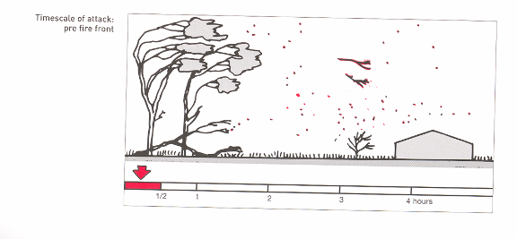
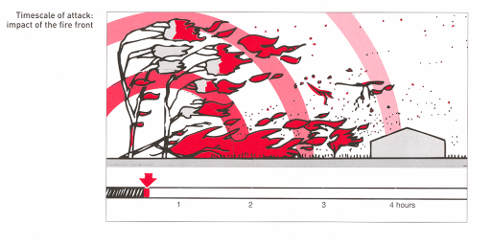
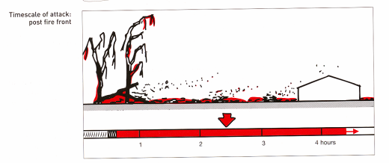
A building will be exposed to the main flame front of a wildfire for a relatively short period of time – 5 to 10 minutes at the most.
Stages of a Wildfire
A building will be exposed to pre- and post-fire for a much longer time.
From: Landscape and Building Design for Bushfire Areas. Ramsay & Rudolph, CSIRO
Notes:
The width of the red bars at the base of each of the three figures on this slide gives a relative indicating of the time interval associated with a given phase of a wildfire, from the perspective of the building. The important point here is that the fire front passes a home quickly. Exposure to embers is much longer. The new building code isn’t intended to allow for survival of a building placed in the middle of a crown fire. Point out that this represents a wildfire exposure, and not your neighbor’s home on an adjacent lot, where the radiant exposure would be longer.

Slide 9
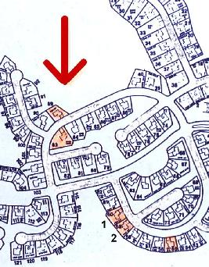
How do houses ignite?
Houses marked in orange burned down
Based on the concept of defensible space, houses 1 and 2 should not have burned down because they were 300 feet from the actual fire
Embers ignited the roof of one house which in turn ignited its neighbor
Flame Front

Slide 10
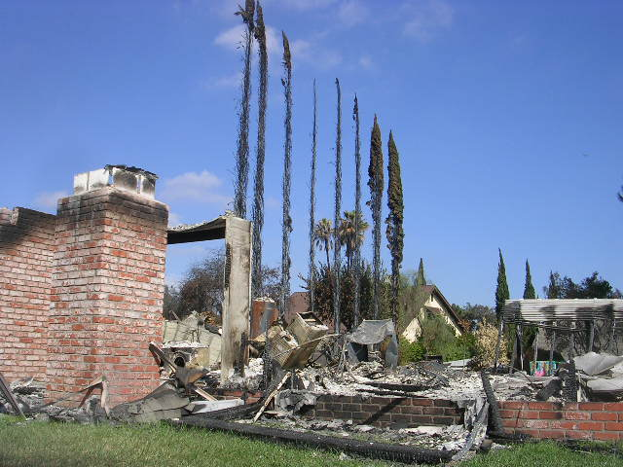
How do houses ignite?
Most damage caused by wind-blown embers
In the Witch Fire area, 13% of houses burned
  Only 2% of houses burned were built after 2004
More than 12,000 structures saved within ¼ mile of fire perimeter
  Defensible space and landscaping
  Fire-resistive building materials and methods
  Personal responsibility to do this!
Notes:
Wind-driver ember attack is more severe; embers can get into places that ignite the structure from the inside such as: attics, garages, or storage areas.

Slide 11
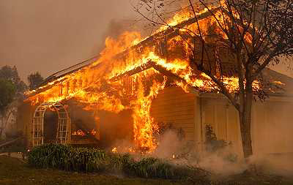
How do houses ignite?
Roofs and roof coverings can cause houses to ignite if:
  Embers land on combustible roof covering
  Embers burn through roof covering
  Embers blow under roof tiles or into vents
  Heat of burning house next door ignites roof
Scripps Ranch 2003

Slide 12
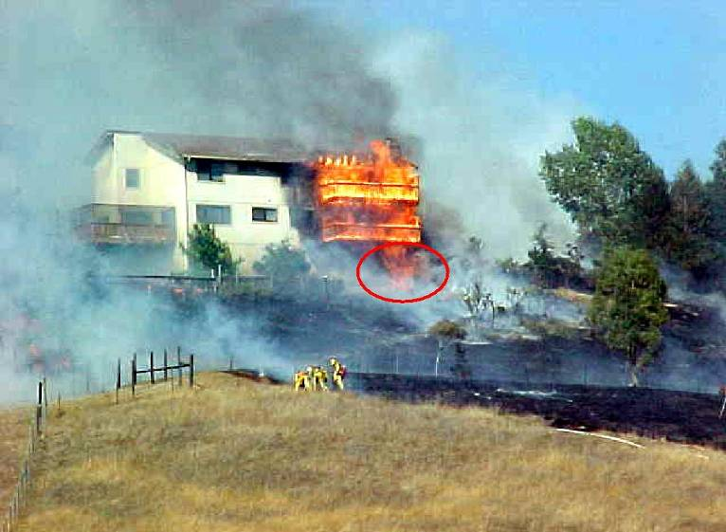
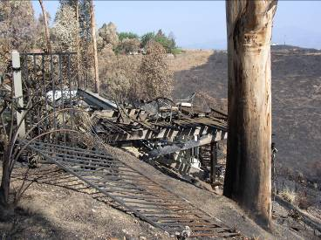
How do houses ignite from the homesite?
Embers land on combustible materials, dead plant material and dry vegetation
If close to structure, heat from burning fuels and vegetation can ignite structure

Slide 13
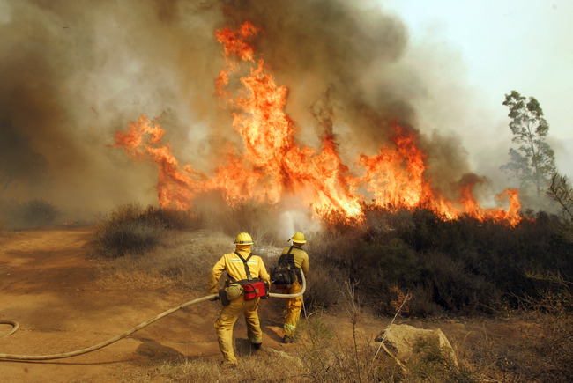
How do houses ignite from the homesite?
Flames contact the house only if something is burning within 30 feet of house
  Plants, structures, furniture, trash
  TV shows scary flames during wildland fires!

Slide 14
SECTION FOR KAY
Landscape architect Kay Stewart will present the practicalities of managing trees and vegetation to reduce structure ignition risks. (w/ science)
REVISE, choose concepts and slides that relate to trees and structure ignition
These slides are from Living with Wildfire presentations

Slide 15
Defensible Space
Refers to the area around a structure where the landscape is managed to reduce the intensity and spread of wildfire
  Reduces heat that structure is exposed to
  Removes places that embers can land
  Reduces adverse effects on native habitats
Part of the Home Ignition Zone
  Includes the structure and homesite
  Out to 100 feet… may include your neighbor’s property!

Slide 16
Defensible Space
Provides firefighters a safer space to defend the house
  If firefighters are not available, defensible space improves the likelihood a structure will survive without assistance
  Prevents a fire in your house from spreading to the wildland
Remember, YOU are the most effective firefighter by preparing your structure and homesite for the eventual wildfire

Slide 17
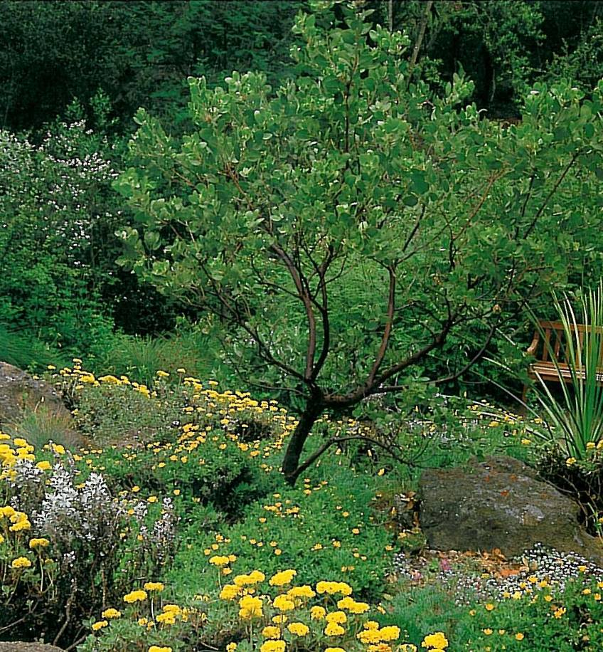
How do you reduce risks with “fire-wise” homesite design and maintenance?
Where’s the vegetation?
Pruning
Plant selection
Weeding
Irrigation
“The Built Landscape”

Slide 18

What’s next to the structure?
Within 3 to 6 feet of structure
No mulch, bark, or pine needles
Use stones, decomposed granite
Remove dead branches so embers won’t have fuel to burn
Remove lawn furniture, woodpiles and trash

Slide 19
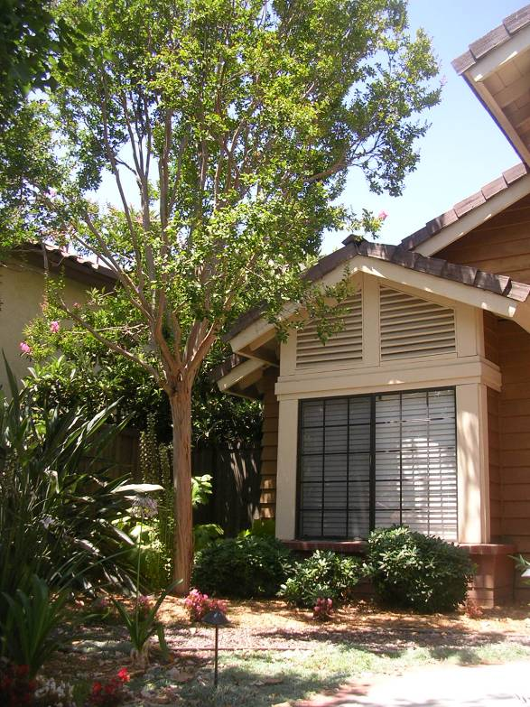
Maintenance: Tree Pruning
Landscape plants can easily become ladder fuels for the fire
Prune limbs of mature trees to reduce ladder fuels
  6 feet up from the ground
  Or 1/3 of live-crown height
Prune limbs 10 feet from chimney
Prune limbs hanging over roof and gutters OR clean gutters
Don’t cut down trees unnecessarily!

Slide 20
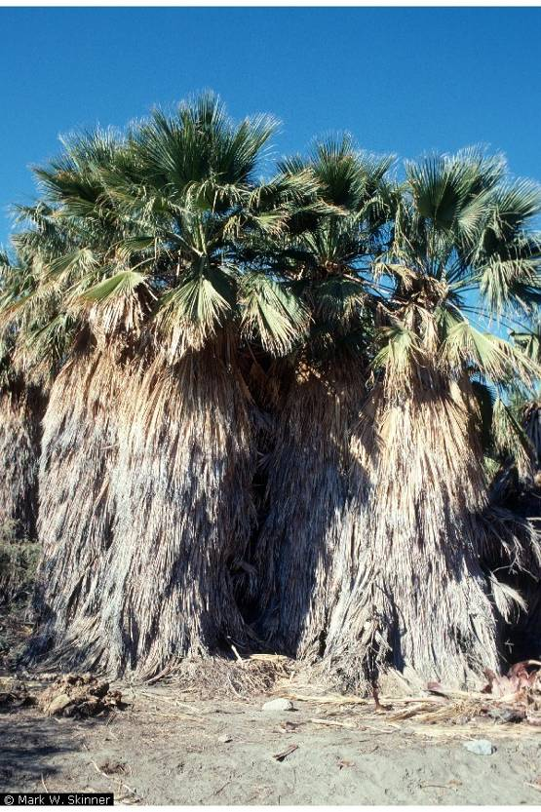
Maintenance: Fan Palms!
Embers ignite dead fronds
Fronds ”fly through the air” as monster embers
Seeds spread through easily to canyons and other yards
Must prune annually to remove flammable dead fronds—expensive!

Slide 21
Homesite Maintenance to Reduce Wildfire Risks
Clear debris from areas around the house
Move woodpile and “stuff” at least 30 feet away
Replace combustible patio furniture
Eliminate “ember-catchers” from landscaping
Store fabric cushions indoors when winds or wildfires predicted

Slide 22
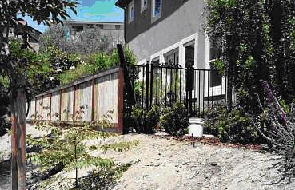
Focus on the Home Ignition Zone
Create sustainable, fire-wise environments for our homes by starting from the house out rather than from the wildland in
  Building materials and design
  Landscape maintenance
  Personal responsibility
  Community cooperation

Slide 23
Statistics for defensible space
Syphard, Brennan and Keeley. 2014. The role of defensible space for residential structure protection during wildfires. Intl J. Wildland Fire
Aerial photography for 1000 destroyed and 1000 surviving structures for 2001 to 2010 fires in San Diego County
Most effective treatment distance varied between 5 and 20 m from the structure, but distances larger than 30 m (100 ft) did not provide additional protection, even for structures located on steep slopes. The most effective actions were reducing woody cover up to 40% immediately adjacent to structures and ensuring that vegetation does not overhang or touch the structure.

Slide 24
https://disastersafety.org/wildfire/
5 to 30 ft from structure
Place trees and shrubs in well-spaced groupings and keep them main­tained. Eliminating ladder fuels and creating separation between plants or plant groupings are techniques used to fulfill this objective.
Create islands or groupings of vegetation to form a discontinuous path of vegetation to make it difficult for the fire to burn directly to your home. Remove dead material and lower tree branches, and shrubs positioned under trees so that a surface fire cannot ignite vegetation what will allow fire to spread into the tree crown. This is often referred to as removing ladder fuels. Remove dead plant material and tree branches from vegetation on a regular maintenance schedule.
Maintain trees by keeping a minimum horizontal spacing of 10 feet between crowns, with the distance increasing with increasing slope. Prune limbs and branches to a height of up to 15 feet. For shorter trees, pruning should not exceed 1/3 of the tree height.

Slide 25
SECTION FOR LYNNETTE
CalFire urban forester Lynnette Short will bring agency experience that trees in close proximity to structures remain intact, during and after wildfires. Trees and vegetation do not threaten homes or lives, if they are managed properly in defensible space and they are maintained in healthy condition.
SHORTEN

Slide 26
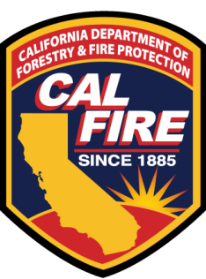
Fire in the Urban Landscape
What Urban Foresters can do to help maintain the urban forest in fire prone areas
Lynnette Short
CAL FIRE – Urban and Community Forestry Program
San Diego Regional Urban Forests Council
Urban Forestry Summit
October 3, 2018

Slide 27
Objectives
What are the issues?
  Are trees and vegetation a threat to homes and lives?
  Unnecessary removal or exclusion of trees
What led us to these issues?
What have we learned?
What can Urban Foresters can do to help?

Slide 28
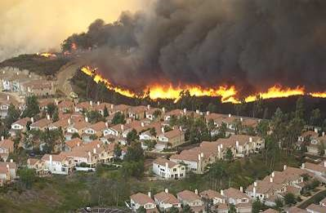
Are all trees and vegetation a threat to homes or lives?
If managed properly – No
  Defensible space
  Condition of the trees
Notes:
2 main factors that affect the outcome of whether vegetation or trees contribute to the spread of fire in the WUI.
Defensible space – which refers to the tree’s spacial location relative to a structure
Overall condition of the tree – probably the most important factor when determining whether a tree is a fire threat

Slide 29
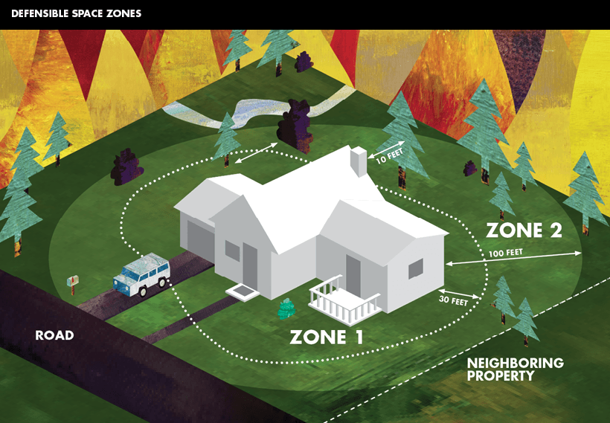
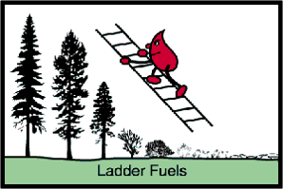
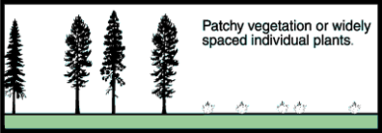
Defensible Space
Notes:
Not going to go into depth on this, just want to point out that Defensible space plays a role in structure survivability for wildfires.
CAL FIRE sets a state standard, local governments follow those standards, and at times make their codes more stringent.
Horizontal and Vertical continuity of the fuels.

Slide 30
Conditions of the trees
Many factors determine condition
  Fuel moisture
  Dead to live ratio
  Overall health
Notes:
Probably the more prominent factor is the overall condition of the tree/vegetation
In vegetation management we look at horizontal/vertical continuity, fuel moisture, and dead to live ratio when modeling for fire behavior predictions. Similarly for trees – we’re looking at the overall condition of the tree. A more stressed tree is going to be more prone to ignition.
All fuels/trees are flammable, however the moisture content and condition largely influence it’s flammability, even during hot, dry climatic conditions.

Slide 31
What led to the issues?
Past events
  Oakland, Ca fires 1991
  California fires 2003
  Melbourne fires 2009
  California fires 2017
Fear
Lack of understanding
Ulterior motives
Notes:
Catastrophic wildfires caused catastrophic loss. AND THERE IS ALWAYS SOMETHING TO BLAME. Right?
Fear – fear perpetuates humans to seek a cause, and sometimes unjustly
Overall lack of understanding the relationship between fire spread and vegetation – like defensible space and conditions
Ulterior motives – native plant activists / sierra club – particularly in the Oakland area. Making claims that non-native tree species are much more prone to fire than native species, and should therefore be removed from the landscape. Eucalyptus example.
Doesn’t it seem like trees always get the blame?

Slide 32
What have we learned?
Trees in close proximity to structures stay intact, during and after wildfires
Main cause of structure loss = fire brands (embers) carried far distances by winds
Homes burned due to:
  Inadequate fire resistant materials
  Lack of defensible space
Trees didn’t burn the houses!
Notes:
or maybe some of us have always known.
Jack Cohen, a fire scientist with the USFS fire lab in Missoula. He has spent decades researching fire behavior in the Wildland Urban Interface areas (WUI).
The common characteristics initiating the disastrous losses in high density residential development are extreme wildfire conditions in surrounding wildlands producing firebrand showers that ignite homes directly.
“…destruction in the WUI is primarily the result of the flammability of the residential areas themselves, rather than the flammability of the adjacent wildlands…Research has shown that a home’s characteristic (construction) and its immediate surroundings principally determine the WUI ignition potential during extreme wildfire behavior.
The trees are not the problem. As for firebrands emitted during a fire, they are generated in all vegetation types. The best strategy to save homes is to harden structures to prevent ignition and maintain surrounding defensible space.

Slide 33
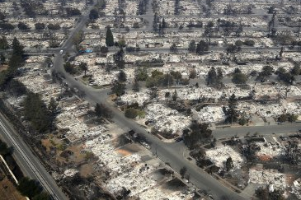
Tubbs Fire, Santa Rosa 2017

Slide 34
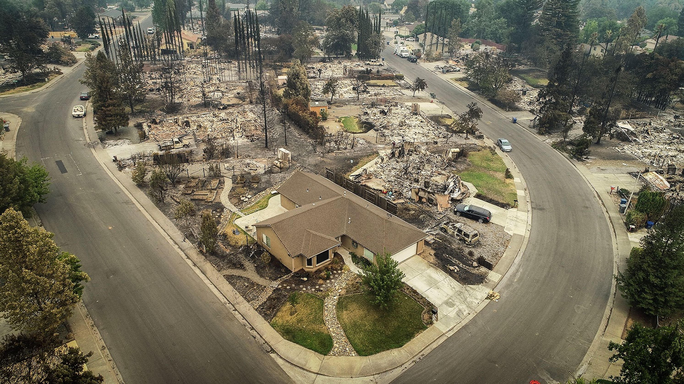
Tubbs Fire, Santa Rosa 2017

Slide 35
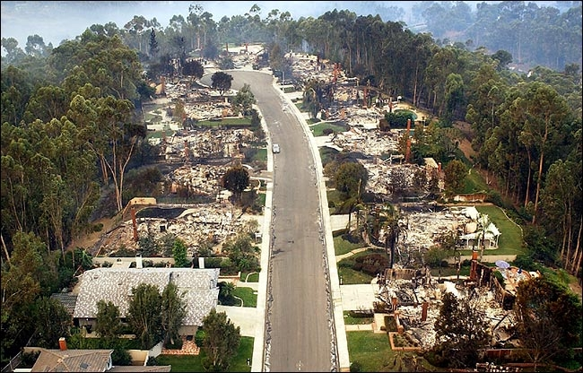
Cedar Fire, San Diego 2003

Slide 36
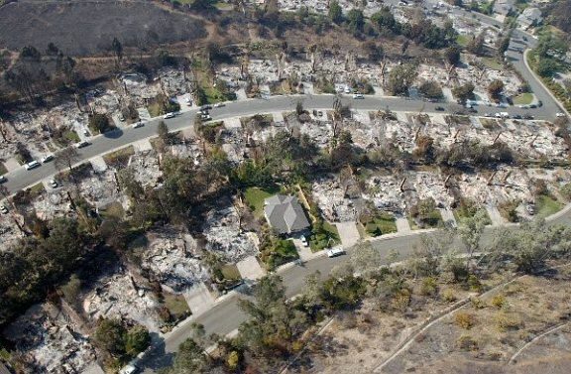
Cedar Fire, San Diego 2003

Slide 37
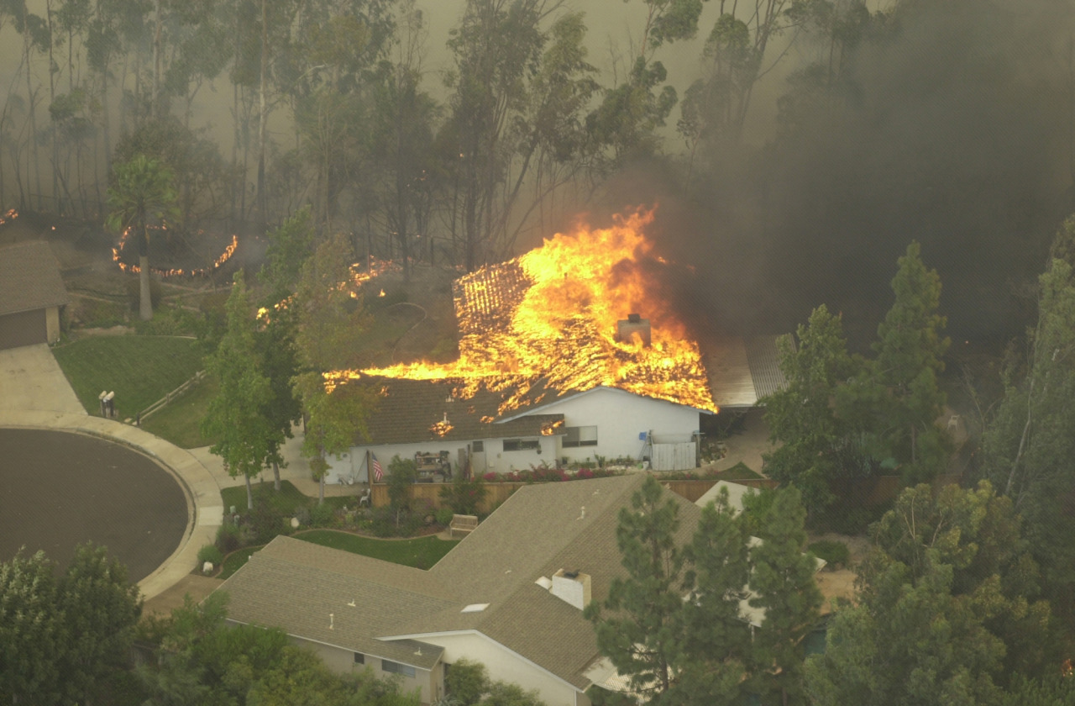
Cedar Fire, San Diego 2003

Slide 38
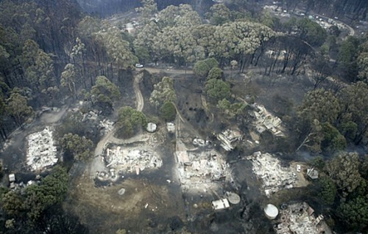
Melbourne, Victoria Australia, 2009
Notes:
The Melbourne Australia fires of 2009 killed nearly 173 people and burned thousands of structures. The primary canopy in this area is eucalyptus globulus – and post fire it was found that these trees remained largely intact.

Slide 39
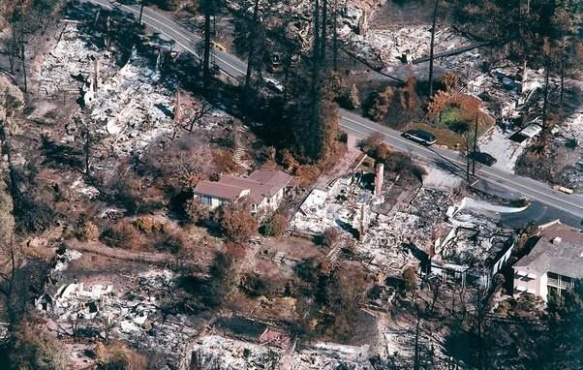
Trees may have shielded house from embers

Slide 40
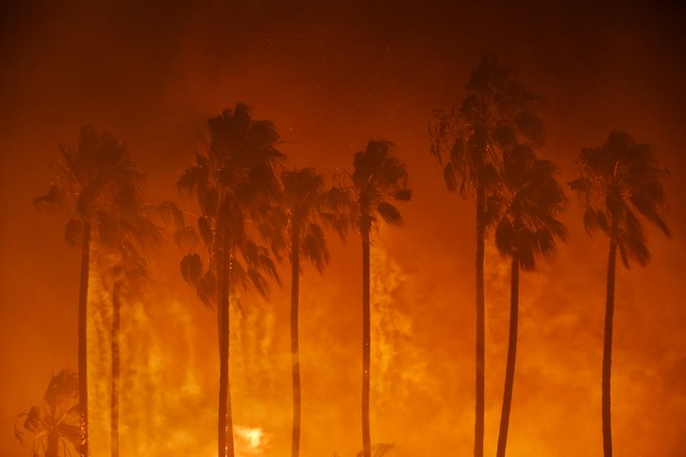
Mexican palms, spreading wildfire in neighborhoods

Slide 41
What can we do?
Know your local fire codes
Work with city planners and fire inspectors
References
  Jack Cohen, retired fire scientist, US Forest Service https://www.fs.fed.us/rmrs/science-spotlights/protecting-your-home-wildland-fire
  Protecting your home from wildfire https://disastersafety.org/ibhs/protecting-your-business-from-wildfire/
Notes:
First educate yourself on how your local codes affect trees. See if there are un-warranted species exclusion lists
Same as getting trees worked into planning documents – you have to fight for them – need justification
Need to make ourselves accessible to the creators of local fire safe codes and defensible space standards

Slide 42
SECTION FOR ANNE
The physics and principles of structure ignitions will first be outlined, focused on wind-driven embers and combustible materials on or near the structure.
State vs. local tree requirements
Continuing “anti-tree-bias” for wildfires, solar panels, sidewalks, etc., need to focus on tree values-assets
Propose revision of City brush code to 10 feet from chimneys (fr state regs)

Slide 43
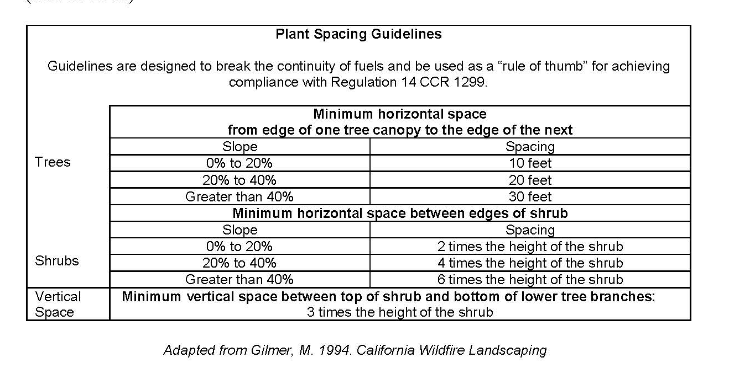
Plant Spacing Guidelines, from General Guidelines for Creating Defensible Space (CalFire 2006)

Slide 44
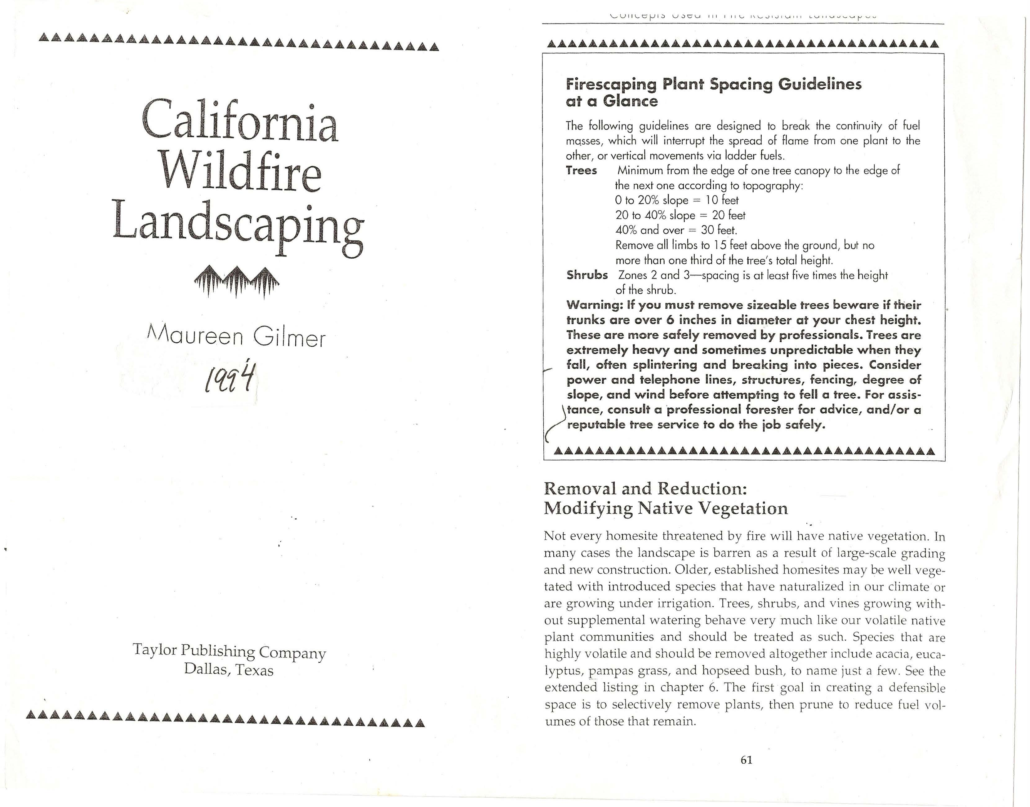
Gilmer 1994

Slide 45
California Code
CalFire PRC 4291, https://codes.findlaw.com/ca/public-resources-code/prc-sect-4291.html
(1) Maintain defensible space of 100 feet …. This paragraph does not apply to single specimens of trees or other vegetation that are well-pruned and maintained so as to effectively manage fuels and not form a means of rapidly transmitting fire from other nearby vegetation to a structure or from a structure to other nearby vegetation.
(4) Remove that portion of a tree that extends within 10 feet of the outlet of a chimney or stovepipe.
(5) Maintain a tree, shrub, or other plant adjacent to or overhanging a building free of dead or dying wood.
(6) Maintain the roof of a structure free of leaves, needles, or other vegetative materials.

Slide 46
CitySD land development code,
Chapter 14, Article 2, Division 4: Landscape regulations
§142.0412
(4) Trees within Zone One shall be located away from structures to a minimum distance of 10 feet as measured from the structures to the drip line of the tree at maturity in accordance with the Landscape Standards of the Land Development Manual.

Slide 47
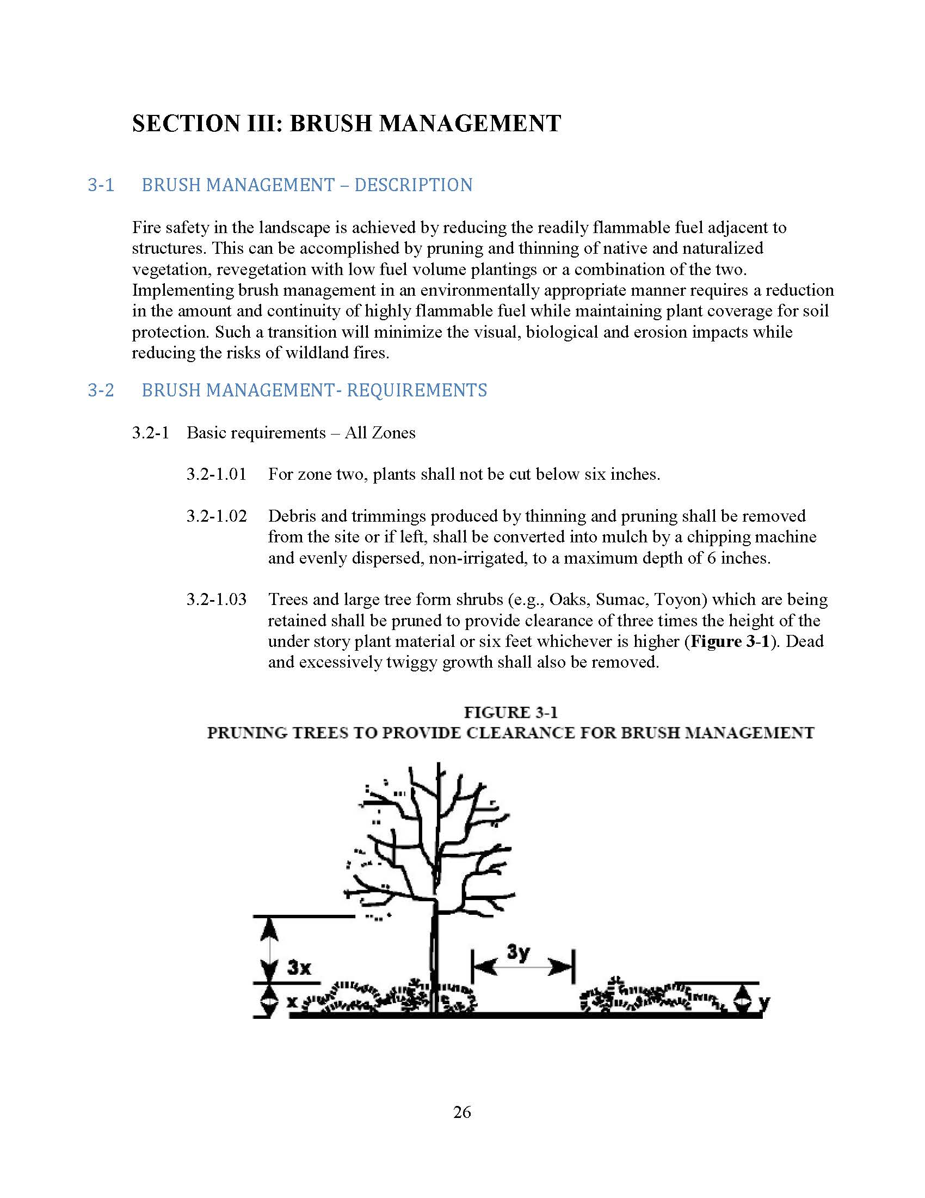
City of San Diego. Landscape standards
SECTION III: BRUSH MANAGEMENT
3-2 BRUSH MANAGEMENT- REQUIREMENTS
3.2-1 Basic requirements – All Zones
3.2-1.03 Trees and large tree form shrubs (e.g., Oaks, Sumac, Toyon) which are being retained shall be pruned to provide clearance of three times the height of the under story plant material or six feet whichever is higher (Figure 3-1). Dead and excessively twiggy growth shall also be removed.
3.2-2.02 Trees should not be located any closer to a structure than a distance equal to the tree’s mature spread.

Slide 48
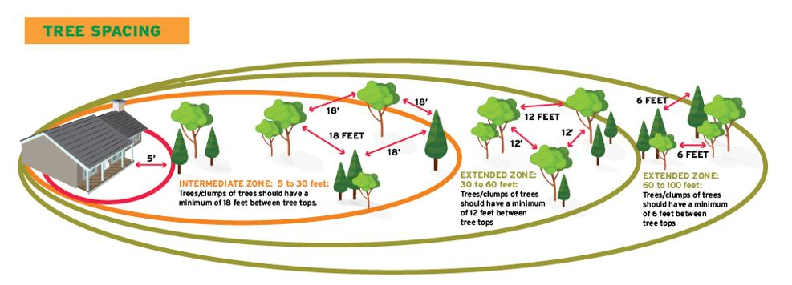
Tree spacing, what’s the science here?
Firewise sketch of trees, https://www.nfpa.org/Public-Education/By-topic/Wildfire/Preparing-homes-for-wildfire

Slide 49
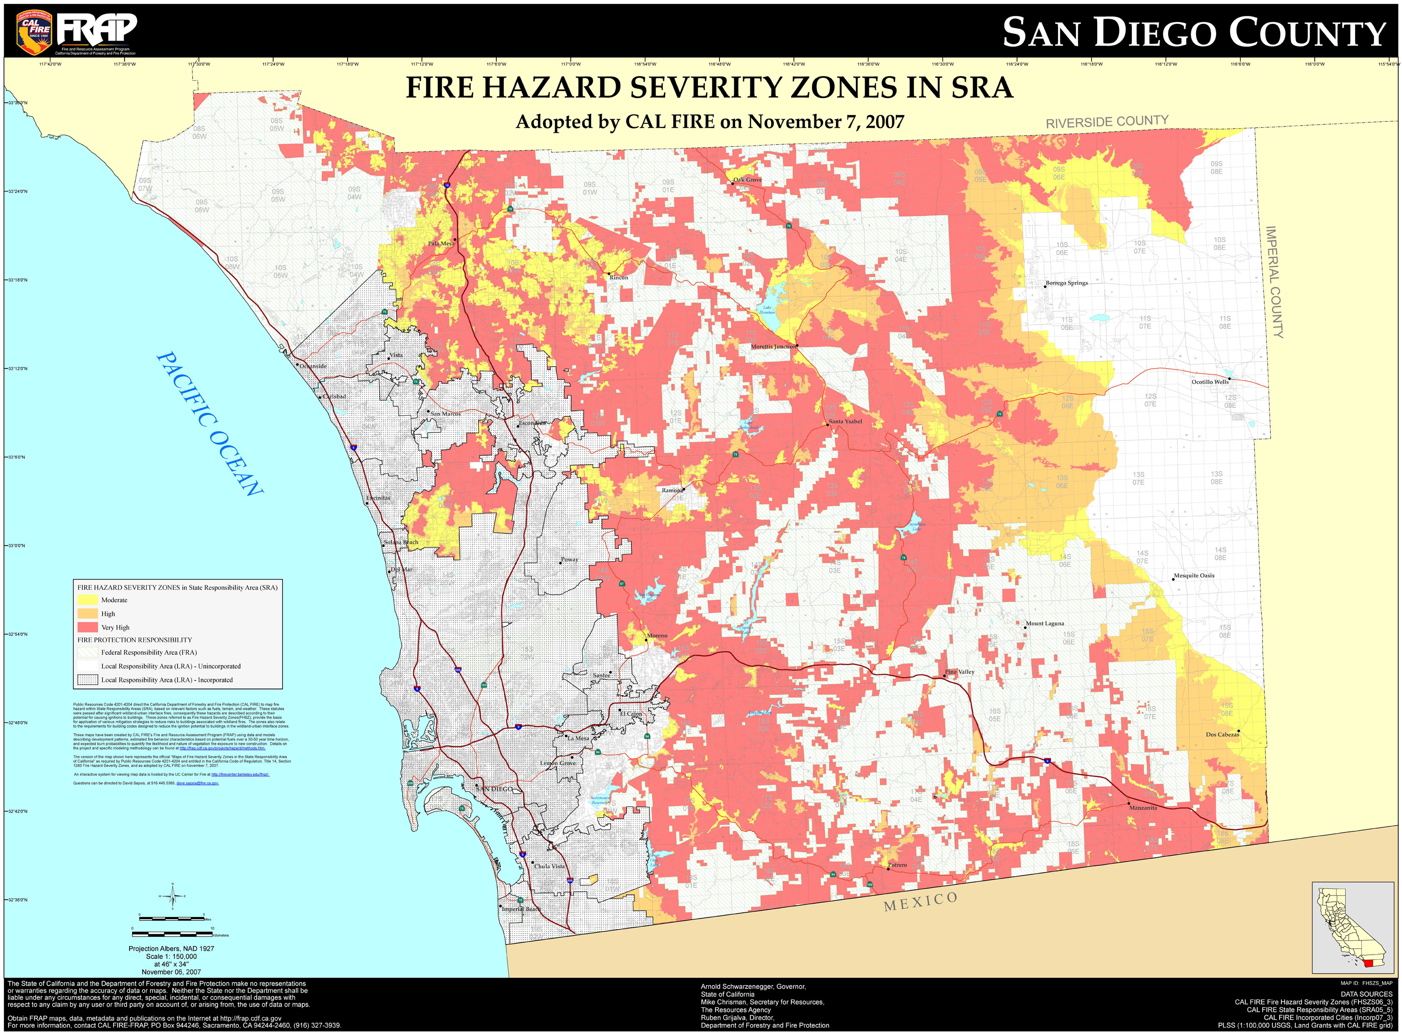
Fire Hazard Severity Zone maps, SRA

Slide 50
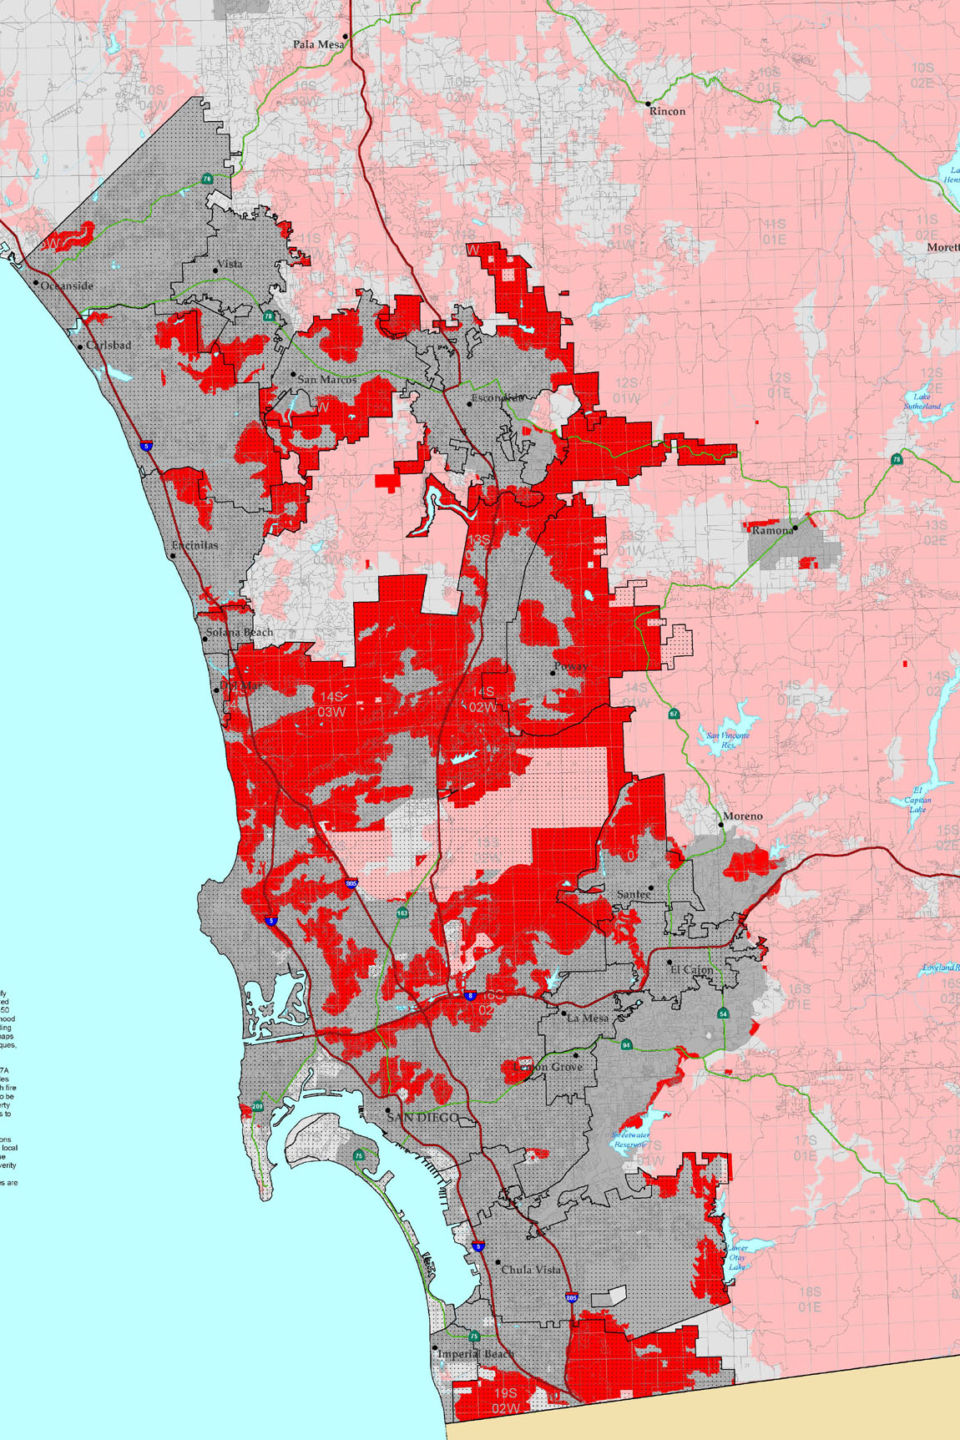
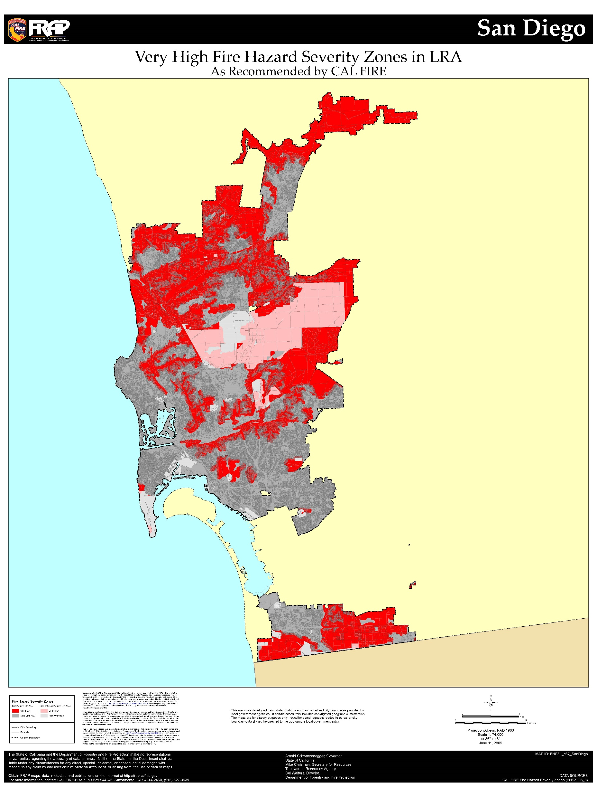
Fire Hazard Severity Zone maps, LRA

Slide 51
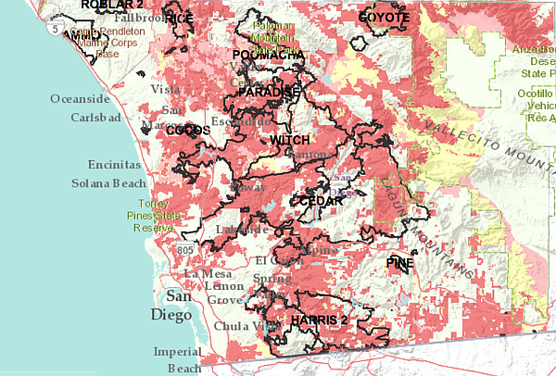
Fire Hazard Severity Zone maps w/ fire perimeters

Slide 52
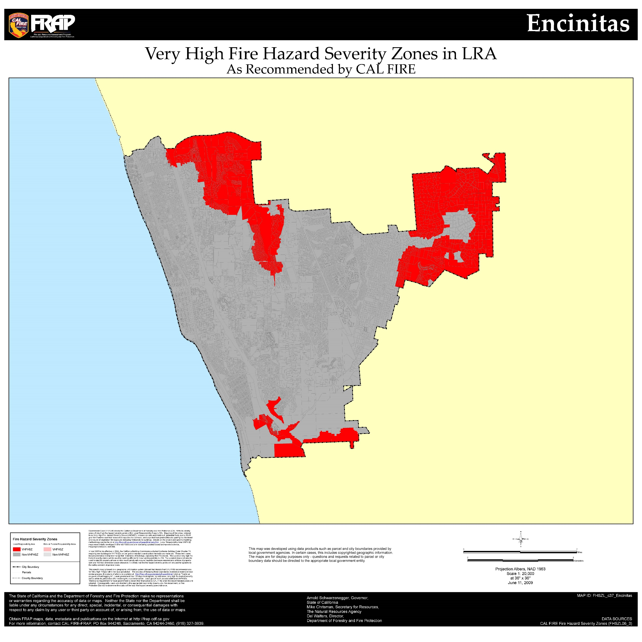
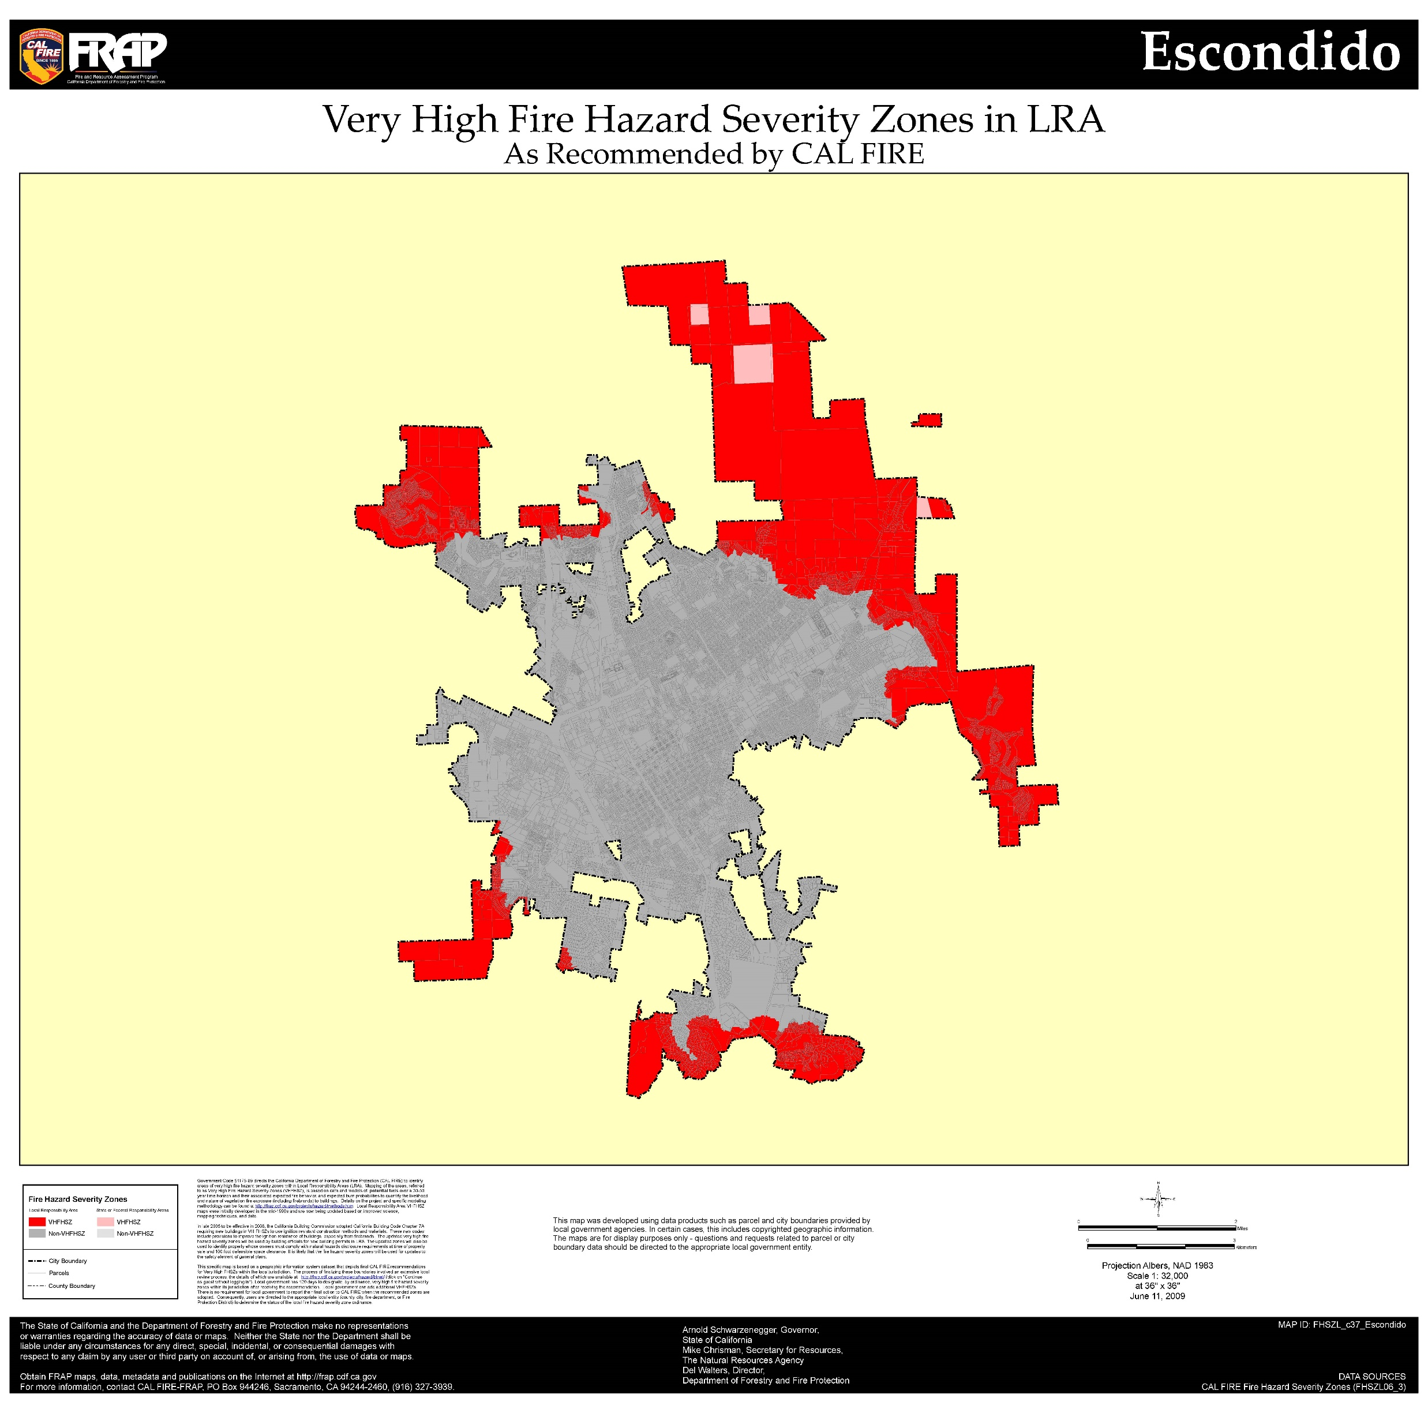

Slide 53
SAN DIEGO REGIONAL URBAN FORESTS COUNCIL
CLEARANCE STANDARDS FOR TREES
SAN DIEGO COUNTY, CALIFORNIA 2010 at http://sdrufc.com/wp-content/uploads/2019/05/SDRUFC-Clearance-Stds.-12_01_10.pdf
1.4 Clearance Standards
The following minimum clearances for tree canopies are to be achieved at the time of pruning.
1.4.1 streets, roads, fire lanes and the traveled way in parking lots: 14’ above the curb or edge of the traveled way.
1.4.2 driveways: 14’ overhead clearance and 16’ horizontal clearance (8’ from either side of the centerline of the driveway). Local agency requirements may specify a greater horizontal clearance depending on the number of properties accessed by the driveway.
1.4.3 buildings and structures: 3’ from the sides and 5’ over the roof.
1.4.4 chimneys: 10’ from the side or above the outlets from chimneys or flue pipes.

Slide 54
SAN DIEGO REGIONAL URBAN FORESTS COUNCIL
CLEARANCE STANDARDS FOR TREES
SAN DIEGO COUNTY, CALIFORNIA 2010 at http://sdrufc.com/wp-content/uploads/2019/05/SDRUFC-Clearance-Stds.-12_01_10.pdf
continued
1.4.5 safety signs, signals and informational road signs: Line of sight, as detailed in local codes or ordinances, shall not be obstructed by tree growth from a clear view by motor vehicle operators. This includes street name signs and property addresses.
1.4.6 vehicle traffic at intersections and turning lanes: Line of sight, as detailed in local codes or ordinances, shall not be obstructed by tree growth from a clear view by motor vehicle operators.
1.4.7 street lights and light poles: 5’ from the sides, above and below the light fixture and the pole supporting the fixture.
1.4.8 sidewalks, walkways and parking spaces in parking lots: 8’ above the paved surface.

